Slide 1
Meeting 14/09/2020
Naudé Conradie
19673418

Slide 2
CPPNs
Rounding threshold vs percentage
Rounding threshold
<1
Percentage
>=1

Slide 3
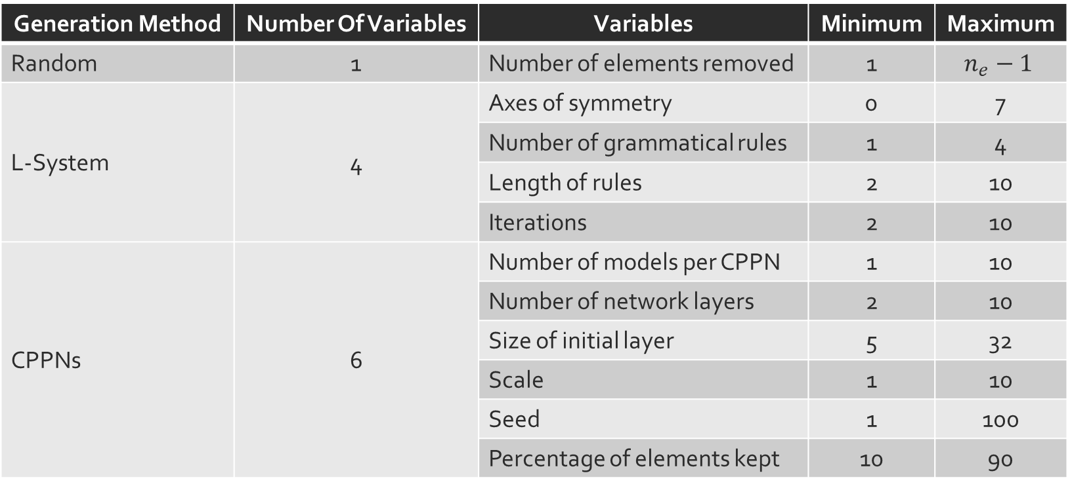
Genetic Algorithms
Generation Method | Number Of Variables | Variables | Minimum | Maximum
Random | 1 | Number of elements removed | 1 | $$n_{e}−1$$
L-System | 4 | Axes of symmetry | 0 | 7
 |  | Number of grammatical rules | 1 | 4
 |  | Length of rules | 2 | 10
 |  | Iterations | 2 | 10
CPPNs | 6 | Number of models per CPPN | 1 | 10
 |  | Number of network layers | 2 | 10
 |  | Size of initial layer | 5 | 32
 |  | Scale | 1 | 10
 |  | Seed | 1 | 100
 |  | Percentage of elements kept | 10 | 90

Slide 4
Genetic Algorithms
Fitness evaluation
Hausdorff distance
Other possibilities

